Slide 1
Amplifier Controls
Team Hi-Potential – Chris Liow
Section 8, Team 3

Slide 2
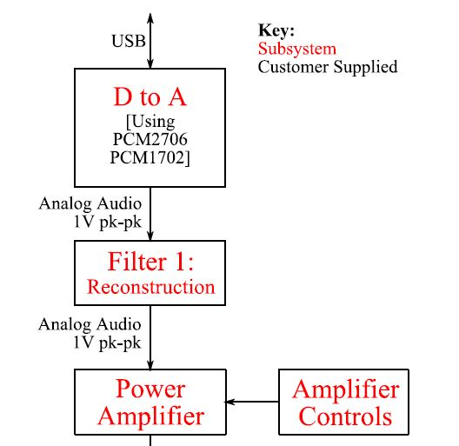
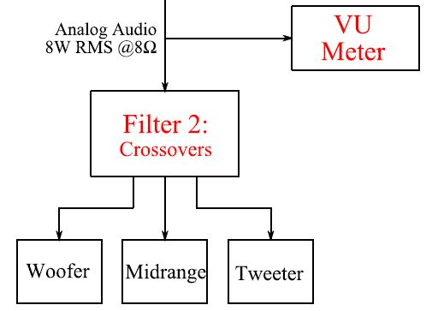
Whole-System Block Diagram
ECE 40200 Course Handout
Purdue West Lafayette, IN 47907

Slide 3
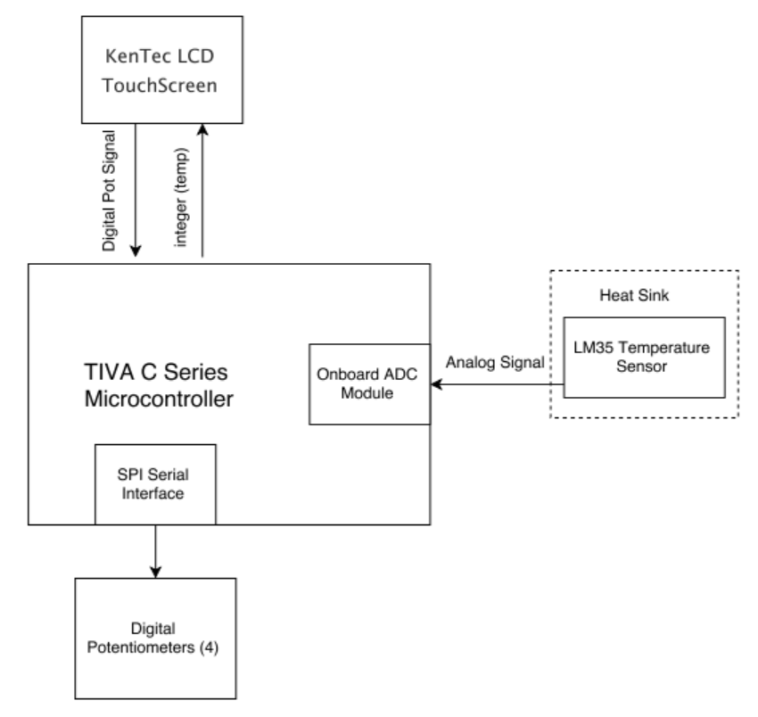
Amplifier Control Subsystem
Detailed Block Diagram

Slide 4
Strategy - What I Have Now
3 Defined ‘Layers’ in Subsystem
‘Hardware/Instrument Layer’
“Components that serve to measure, monitor, or directly influence the signal in the power amplifier subsystem”
Consists of the 4 MCP413 Digital Potentiometers and LM35 Sensor
‘Interpretation Layer’
Bridges the gap between the hardware/instrument layer and the user-interface layer
Includes logic that relates to configuring physical TIVA pins to receive/transmit data as well as logic that interprets said data
‘User-Interface Layer’
TIVA logic that relates to creating the visuals on the LCD
Creates forms and sends user input to the Interpretation Layer

Slide 5
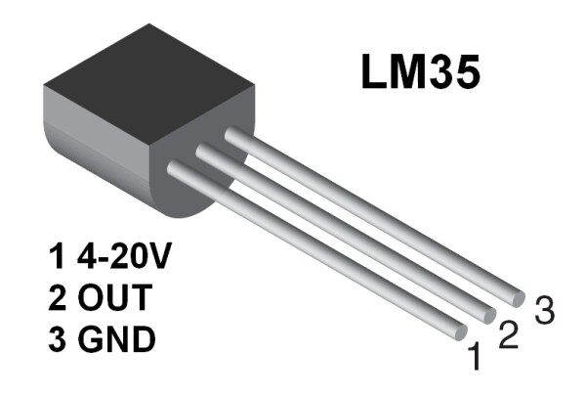
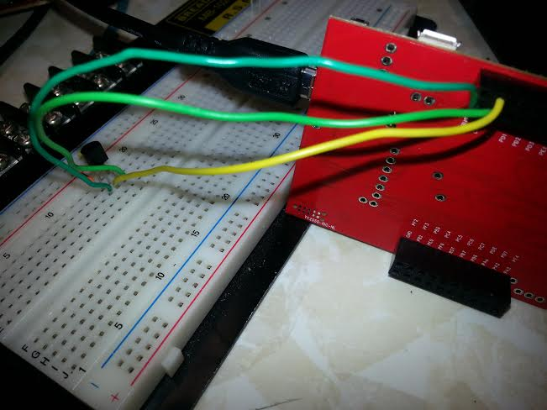
LM35 Temperature Sensor
Linear 0+10 mV/°C Scale Factor
Ex: 23°C >> 10*(23) = 230 mV to input pin
0.5°C Ensured Accuracy (at +25°C)
Read in as analog input, converted to digital reading from onboard ADC

Slide 6
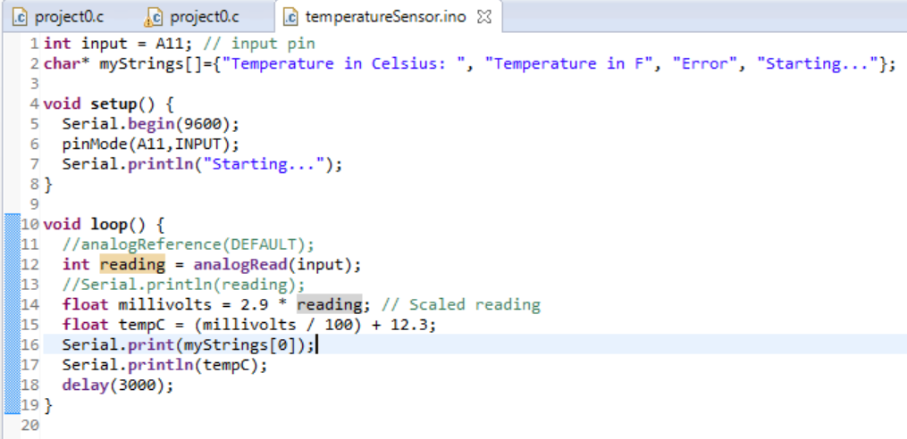
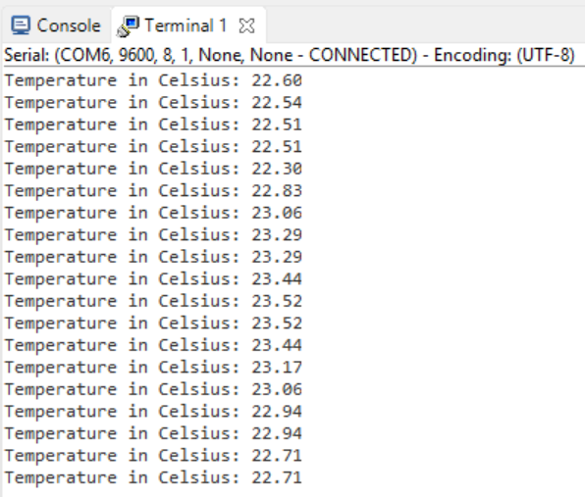

Slide 7
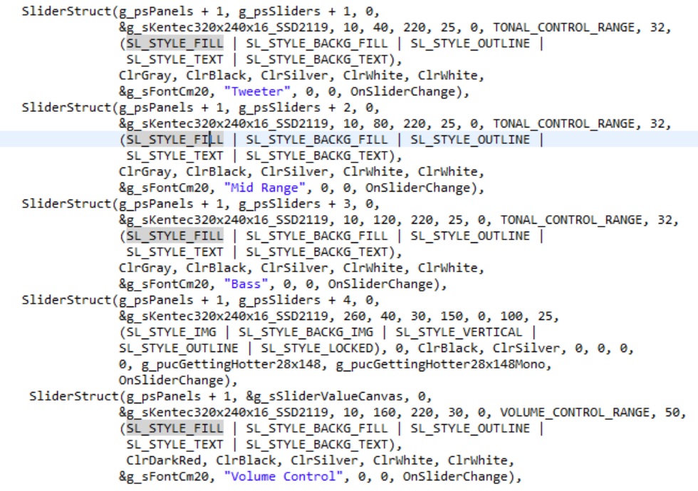
Code Sample - Slider Initialization

Slide 8
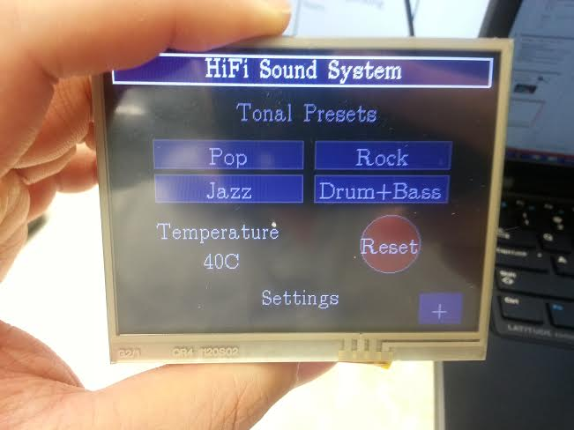

Slide 9
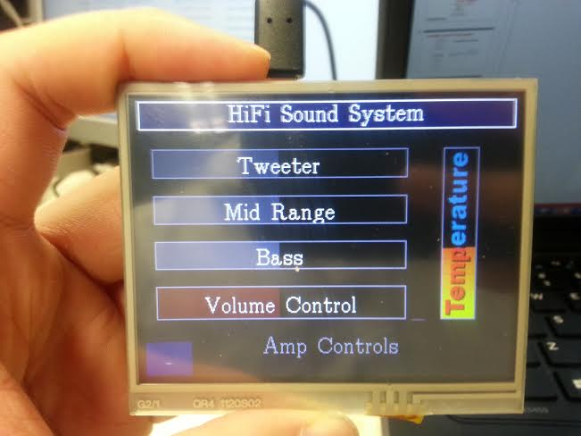

Slide 10
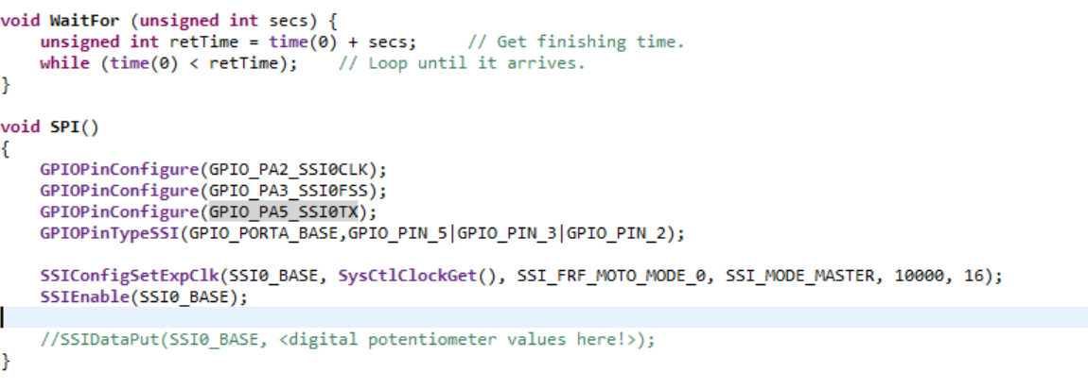
SPI Interface – Framework

Slide 11
Strategy – What’s Next?
3 Defined ‘Layers’ in Subsystem
‘Hardware/Instrument Layer’ – 40% Complete
LM35 Correctly integrated in circuit, tested with Energia Scripts
Digital Pots arriving next week, already planned out procedure
‘Interpretation Layer’ – 25% Complete
Onboard ADC module currently not correctly reading temperature
SPI Interface successful, not been tested with physical potentiometer but with CCS Variable Watch/Expressions
‘User-Interface Layer’ – 95% Complete
Some tweaking and potential extra features depending on customer needs/wants
Necessities are already implemented and tested

